Slide 1

Generative AI Applications in DDI’s Product Portfolio – Research Strategy By - Udit Singh Guleria
Notes:
Hello and welcome, everyone. I'm excited to share with you my plan for our journey in exploring and integrating Generative AI into DDI's product portfolio. This presentation will walk you through our research and development process, highlighting key phases and our strategic approach. I made this presentation to showcase an overview of my strategy for the internship, exploring the the applications of Generative AI in DDI’s Product Portfolio

Slide 2
Phase 1: Preliminary Research and Ideation
Understanding DDI's Current Products: Reviewing the existing product line to identify areas for AI enhancements.
Exploring Generative AI Capabilities: Researching advancements in Generative AI for talent management applications.
Idea Generation: Developing concepts like 'DDI GPT for Assessments' and 'Automated Job Analysis using Generative AI'. Also considering AI-driven leadership training modules and predictive analytics.
Market Research and User Interviews : Existing Clients and Non – Client
Notes:
In Phase 1, we lay the groundwork for our research. It's all about understanding where we currently stand and where we can potentially go with Generative AI. This involves an in-depth review of our existing product line and a thorough exploration of the latest advancements in AI, particularly those that can enhance our talent management solutions.
Market Research and User Interviews : Existing Clients and Non – Client , user testing.com, AMS survey Idea Generation through techniques like Affinity mapping, brainstorming , scamper , lightning demo etc

Slide 3
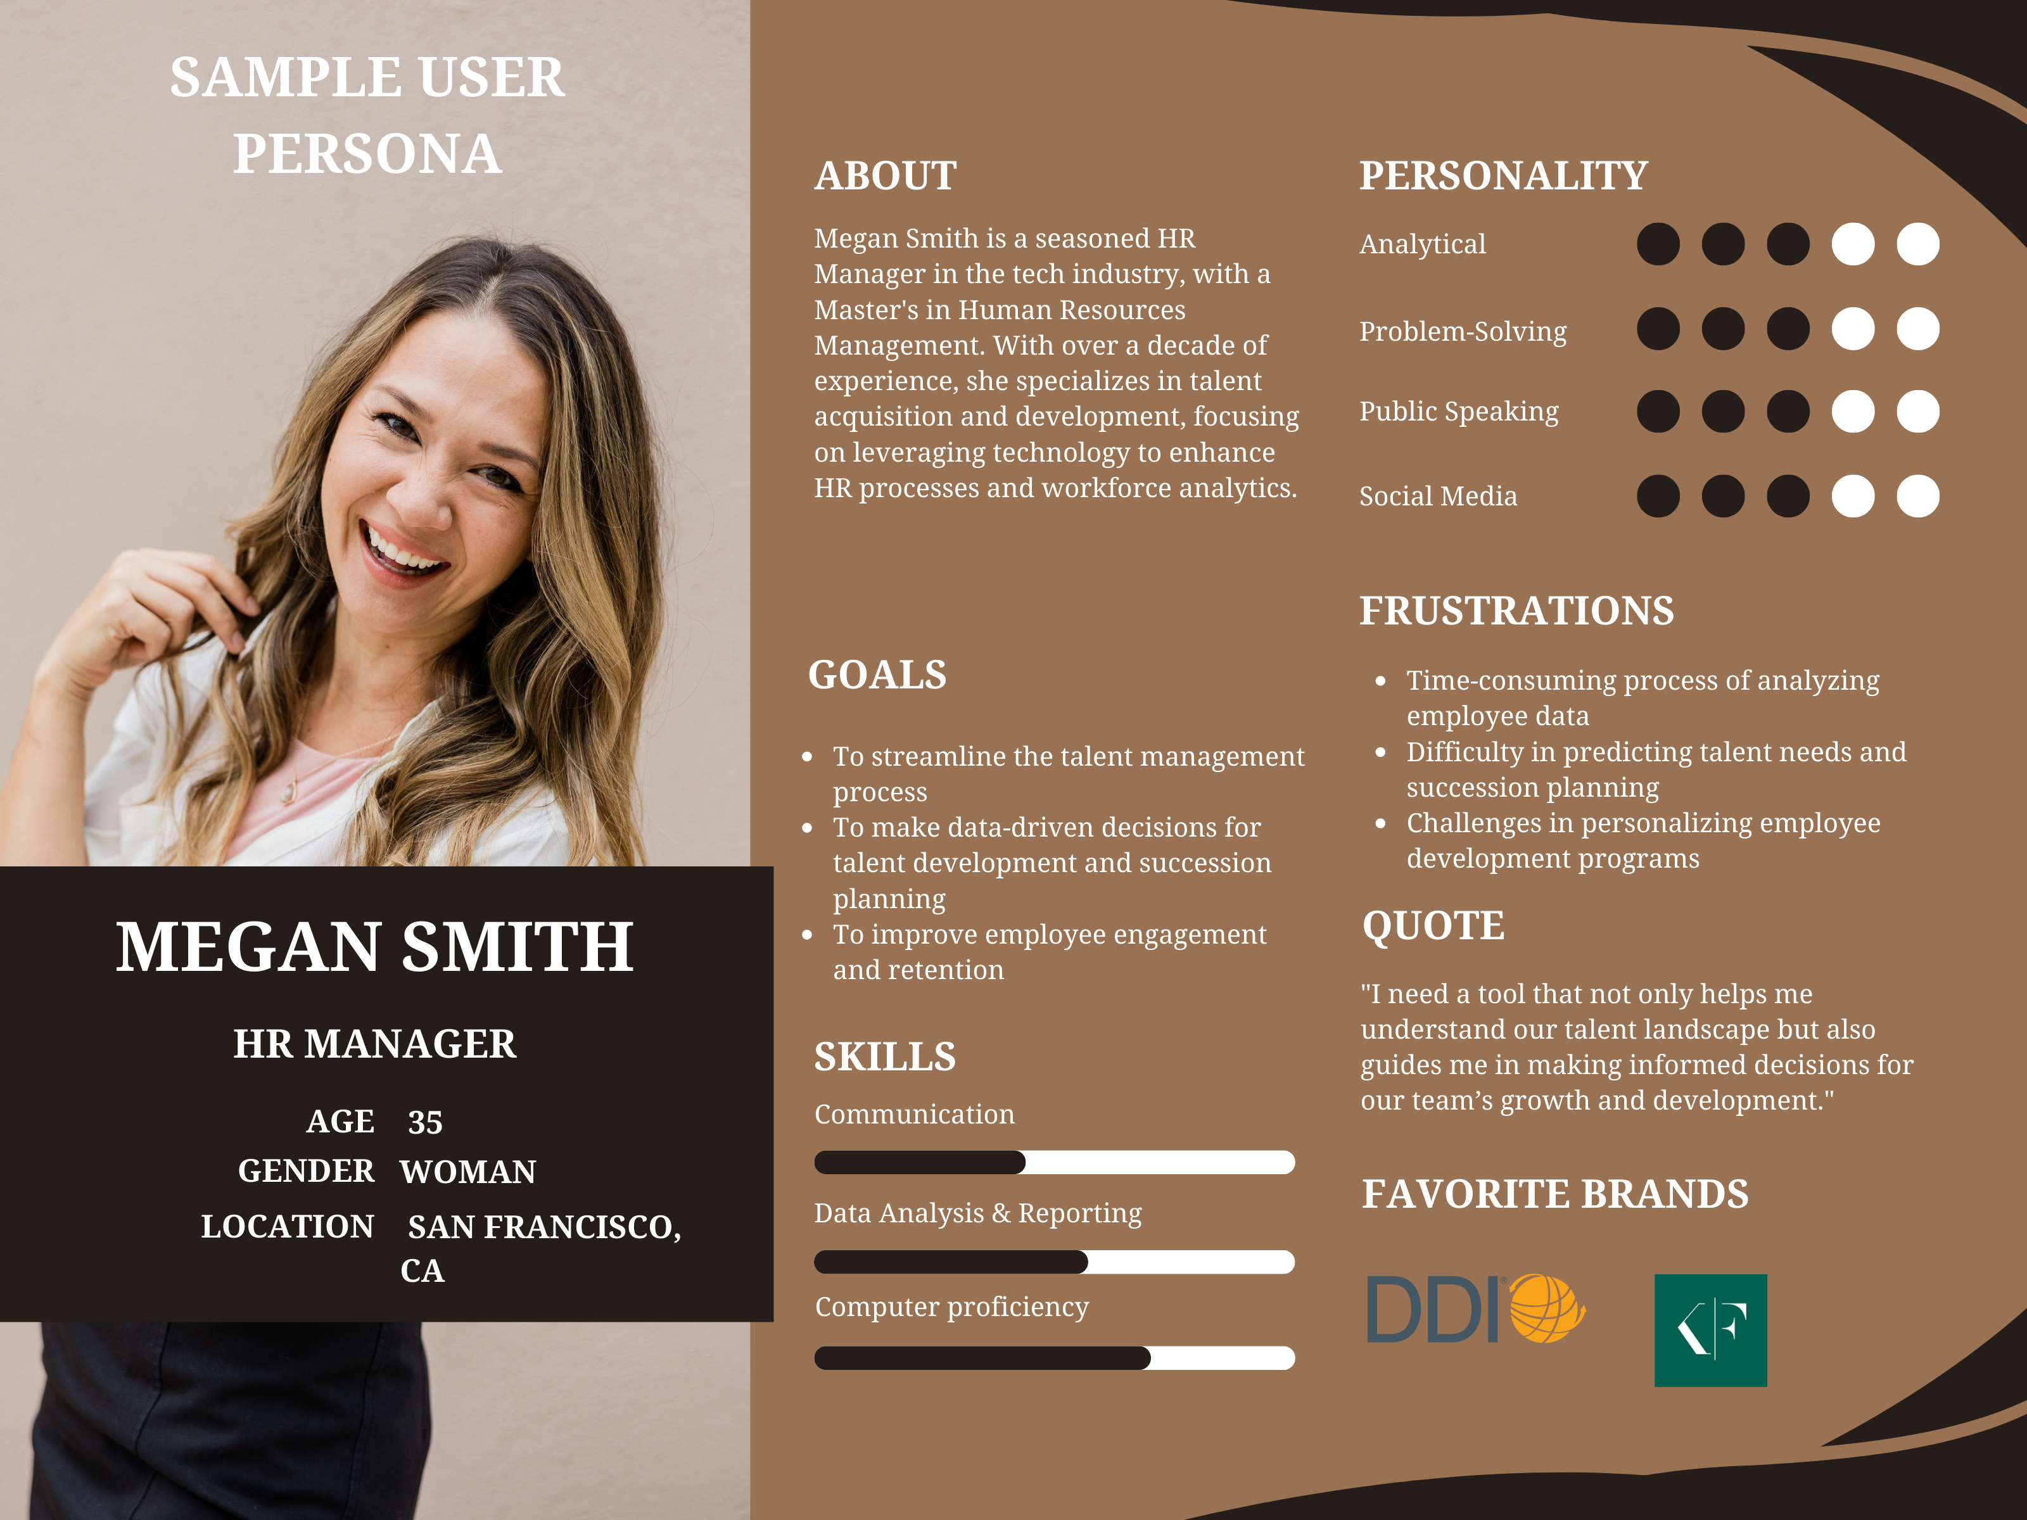
Notes:
User journey map,
Brainstorming: SCAMPER, Affinity mapping, lightning demos

Slide 4
Competitor Analysis
Define
Define the Scope of Analysis: Identify key competitors and metrics for analysis.
Collect
Collect Data: Utilize publicly available information, social media, and product reviews.
Feature
Competitor Product Analysis: Feature comparison and technology stack investigation.
Market
Market Positioning and Strategies: Analyze marketing strategies, sales tactics, and strategic moves.
SWOT
SWOT Analysis: Conduct a SWOT analysis for each competitor and DDI.
Monitor
Ongoing Monitoring: Use tools for real-time updates and regular competitive landscape reviews.
Reporting
Reporting and Application: Compile a report and use insights for strategy development.
Utilize
Tools and Resources: Utilize competitive intelligence and business intelligence tools.
Notes:
Understanding the competitive landscape is essential for the success of our AI initiatives. In the competitor analysis phase, we take a deep dive into what our competitors, such as Kornferry, are doing, their strengths and weaknesses, and how we can leverage this information to better position our AI solutions in the market. SWOT analysis.
Strategic group analysis.
Porter's five forces.
Perceptual mapping.
BCG Matrix (also called Growth Share matrix)

Slide 5
Phase 2: Feasibility Analysis
Technical Feasibility Assessment: Evaluating the technical integration challenges of Generative AI.
Market Analysis: Conducting research to gauge demand for AI-powered solutions in talent management.
Cost-Benefit Analysis: Analyzing ROI and resource requirements for AI initiatives.
Notes:
Phase 2 is crucial as it determines the feasibility of our ideas. Here, we meticulously evaluate the technical requirements, market demand, and financial implications of integrating AI into our products. It's a phase where we ensure that our AI initiatives are not only innovative but also viable and beneficial to the company.

Slide 6
Phase 3: Prototype Development
Prototype Design: Developing prototypes for the most viable AI applications.
User Testing: Leveraging experience with user testing platforms to test and gather feedback.
Notes:
In the third phase, we start turning our ideas into reality. We develop initial prototypes of our AI solutions, focusing on those that showed the most promise in the feasibility analysis. We then conduct rigorous user testing, gathering feedback that is vital for further development. We can leverage tools such as user testing.com and display our prototype for feedback.

Slide 7
Phase 4: Data Analysis and Refinement
Feedback Analysis: Analyzing user feedback to identify strengths and improvement areas.
Iterative Refinement: Refining AI solutions based on feedback for enhanced effectiveness.
Notes:
Phase 4 is where we refine our prototypes based on the user feedback. This involves analyzing the data collected, identifying key trends and insights, and using this information to fine-tune our AI solutions. The goal is to ensure that our final products are user-friendly, efficient, and meet the market needs.

Slide 8
Phase 5: Final Proposal and Implementation Strategy
Comprehensive Reporting: Compiling findings and recommendations into a detailed report.
Implementation Planning: Developing a plan for integrating AI solutions into DDI’s offerings.
Stakeholder Presentation: Presenting the strategy to DDI’s leadership.
Notes:
The final phase involves bringing everything together. We compile a comprehensive report detailing our findings and outlining a clear strategy for implementing our AI solutions. This phase is critical for ensuring that our hard work translates into tangible enhancements in DDI's product portfolio.

Slide 9
Additional AI Application Ideas
AI-Enhanced Coaching Tools: Personalized feedback tools using AI.
Dynamic Training Content: AI-generated adaptable content for training programs.
AI for Talent Acquisition: Predictive tools for candidate success and organizational fit.
Notes:
Beyond our primary research, I also want to share some additional AI application ideas. These concepts could further revolutionize our approach to talent management, offering cutting-edge solutions to our clients.
DDI GPT for assessments 2. Customized Leadership Development Programs: Generative AI can analyze vast amounts of data related to leadership traits, competencies, and behaviors. It can then generate tailored leadership development programs for individual clients based on their specific needs, industry trends, and organizational culture.
Personalized Coaching and Feedback: By analyzing written or verbal communication patterns, generative AI can provide personalized coaching and feedback to leaders. It can generate insights on communication styles, emotional intelligence, and leadership effectiveness, helping individuals improve their skills and behaviors.
Assessment Tool Enhancement: DDI offers various assessment tools for evaluating leadership potential and performance. Generative AI can enhance these tools by analyzing free-text responses or verbal interactions during assessments. It can provide deeper insights into candidates' thought processes, decision-making abilities, and problem-solving skills.
4. Automated Job Analysis

Slide 10

Thank you!

